Slide 1
April 8th
Abeta Plaque
Abeta Oligomers
Abeta Clearance
Animal model APPTg2576

Slide 2
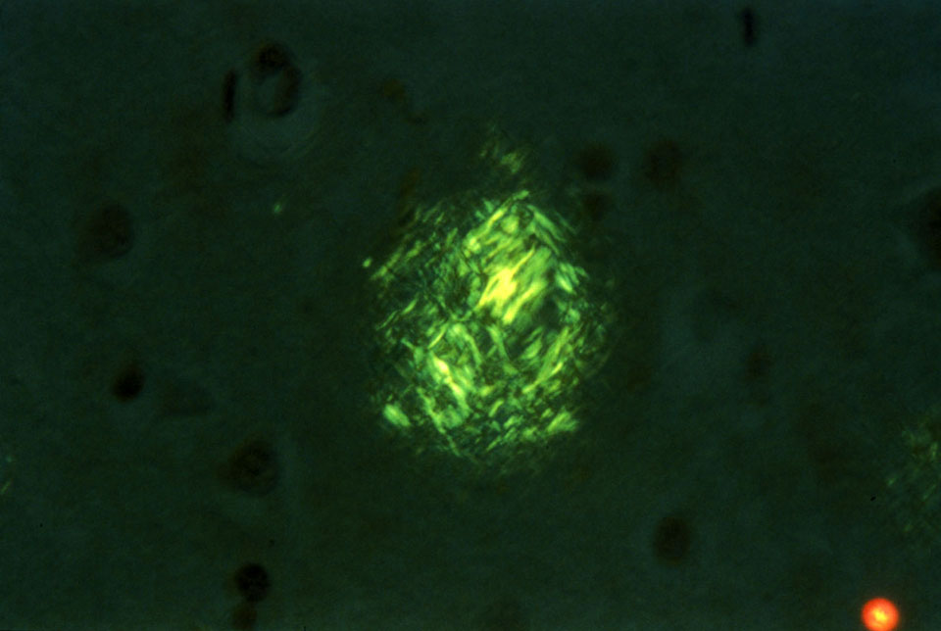
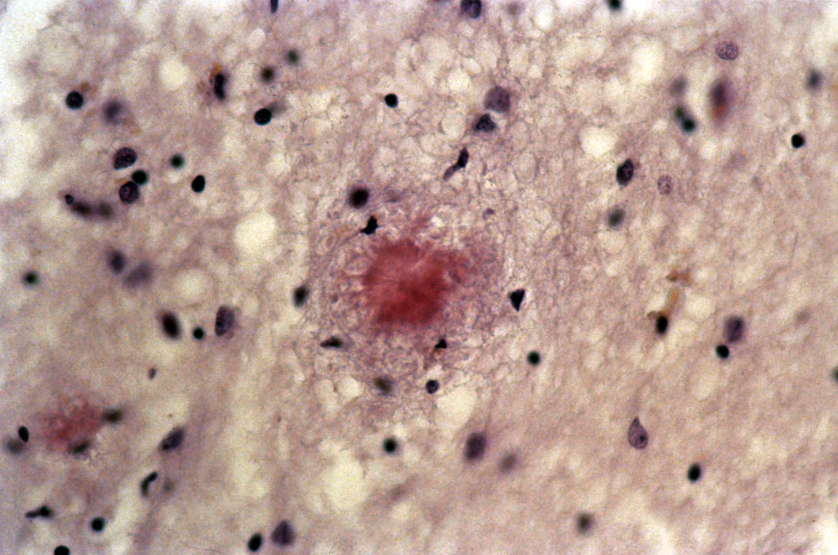
Congo red staining of amyloid plaques
Under polarized light
Under unpolarized light

Slide 3
Can we identify the presence of beta-amyloid plaques for diagnostic purposes?
Pittsburg Compound B versus antibodies specific for β-Amyloid peptides, Aβ 1-40, Aβ 1-42, Aβ 1-43

Slide 4
Antibodies specific for β-Amyloid peptides, Aβ 1-40, Aβ 1-42, Aβ 1-43 for diagnostic purposes
?

Slide 5
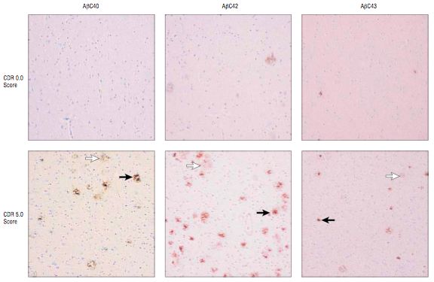
β-Amyloid plaques deposition follows the progression of AD

Slide 6
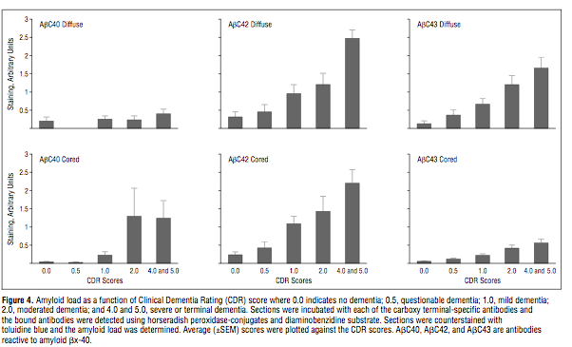
Levels of deposited Aβ40, Aβ42 and Aβ43 follow the progression of the disease

Slide 7
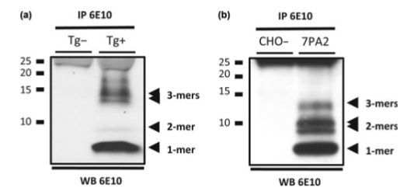
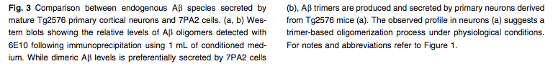
Aβ Oligomers

Slide 8
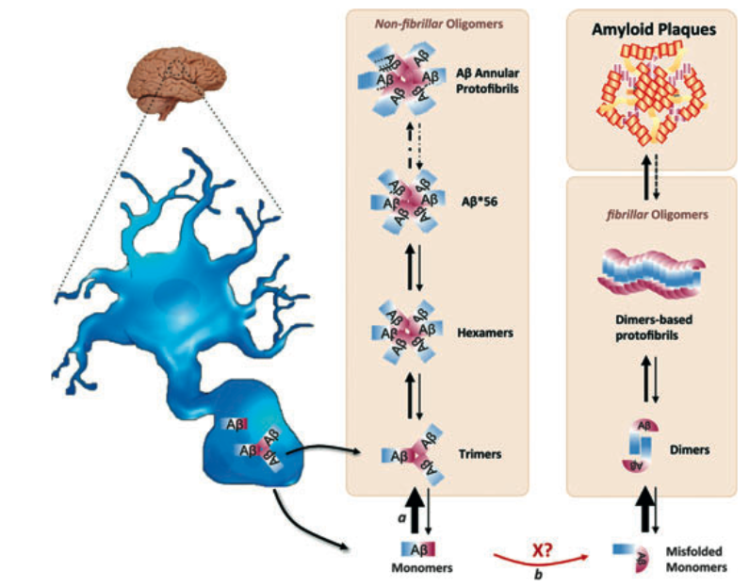
Aβ: Secretion and aggregation into oligomers

Slide 9
Where are Abeta peptides formed?
At an intracellular level, either in late endosomes, ER or in lipid rafts

Slide 10
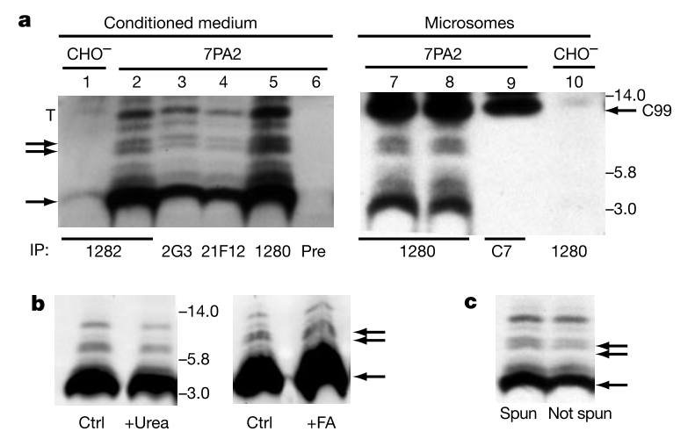
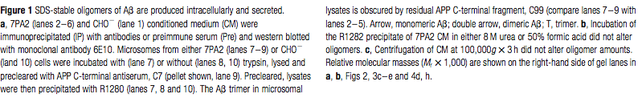
Aβ Oligomers are produced intracellularly and are secreted

Slide 11
How can Aβ peptides reach the extracellular space to form the plaque?
2 hypothesis:
1- Secretion. Aβ peptides are not retained at the phospholipidic membrane, can be secreted in an hydrophilic environment such as the cytosol or the extracellular medium. In vitro, Aβ40 is very well harvetsed in the medium of cultured cells, very low levels of Aβ42 are detectable.
2-Formation of toxic aggregates in the cell. Aβ peptides, formed within the cell, tend to form aggregates (Aβ oligomers) which may have toxic properties and may lead cell death. Intracellualr material including the Aβ aggregates will be released from the cell, and can now be available in the extracellular space to form the core of the plaque.

Slide 12
WHO IS THE ENEMY TO FIGHT IN AD? Plaques or early Aβ formation and deposition?
This is a crucial point in the treatment of AD.

Slide 13
Evidences that Aβ oligomers-induced toxicity is an early event preceding plaque formation
-In humans, levels of cortical soluble Aβ correlate with cognitive decline
-In AD cerebral cortex, monomeric an stable Aβ oligomers (up to ~12kDa in SDS-PAGE).
-Similar oligomers have been detected in the hippocampus and cortex of humans in absence of amyloid plaques, and in many cases in absence of NFT (is Aβ pathology preceding tau pathology?).
-Transgenic animal models overexpressing double mutant forms of APP (Swedish and a modified London mutation, Val717Phe) develop cognitive and behevioral deficit months before the deposition of β-amyloid plaques.
-In neuronal cultures, cell derived soluble Aβ oligomers impair synaptic plasticity.

Slide 14
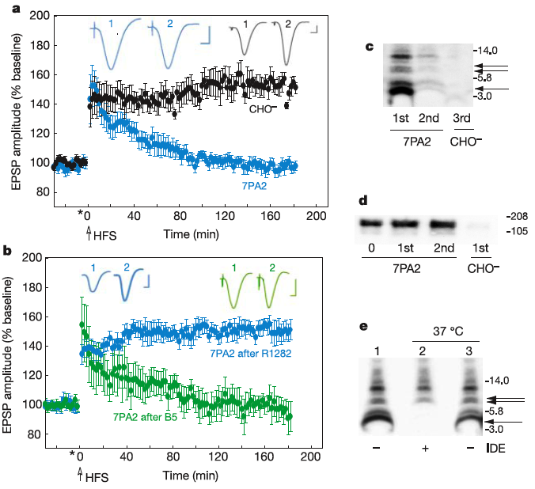
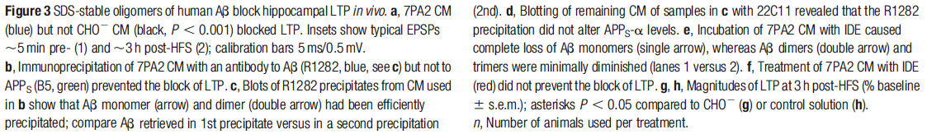
Aβ Oligomers block LTP in vivo
This effect can be reverted in presence of specific Aβ oligomer antibody

Slide 15
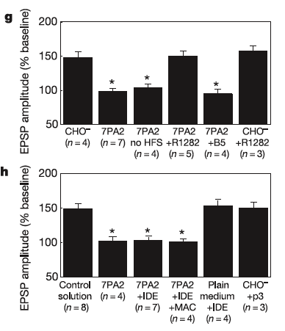
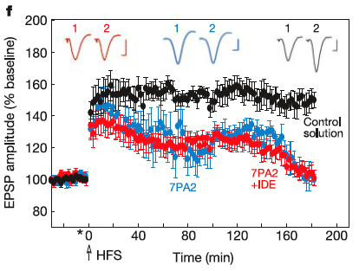
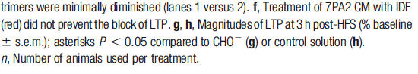
IDE degrades monomers, but NOT oligomers and
DOES NOT rescue LTP

Slide 16
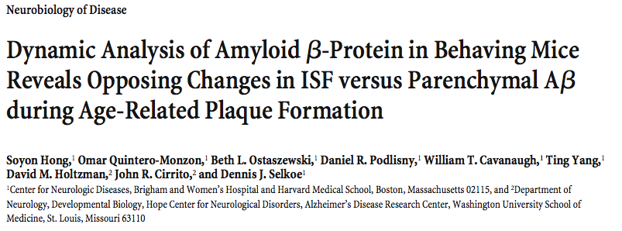

Slide 17
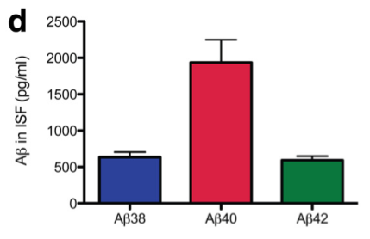
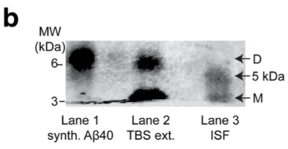
Beta-Amyloid peptides can be detected in the ISF

Slide 18
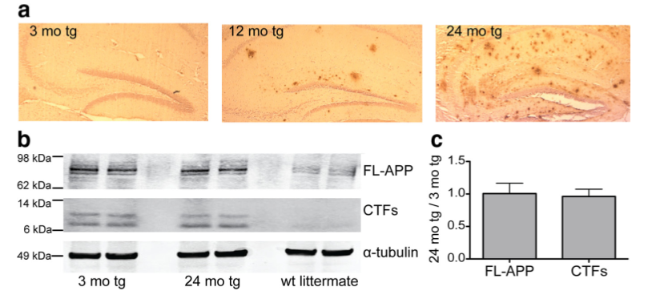
Amyloid plaques develop in J20APPTg mice
without changes in the precursor APP

Slide 19
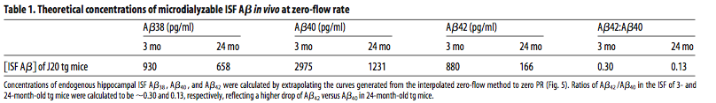
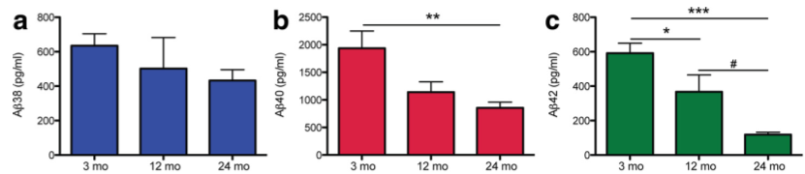
Levels of soluble ISF Abeta decrease with disease progressing…

Slide 20
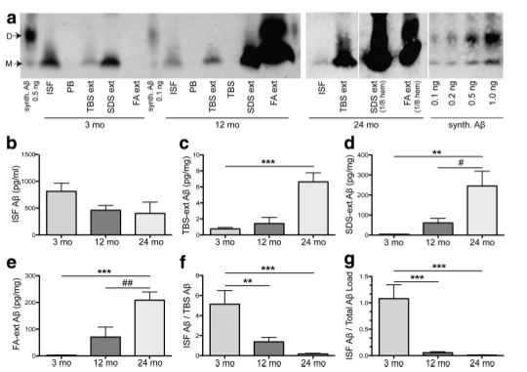
…whereas levels of insoluble Abeta increase

Slide 21
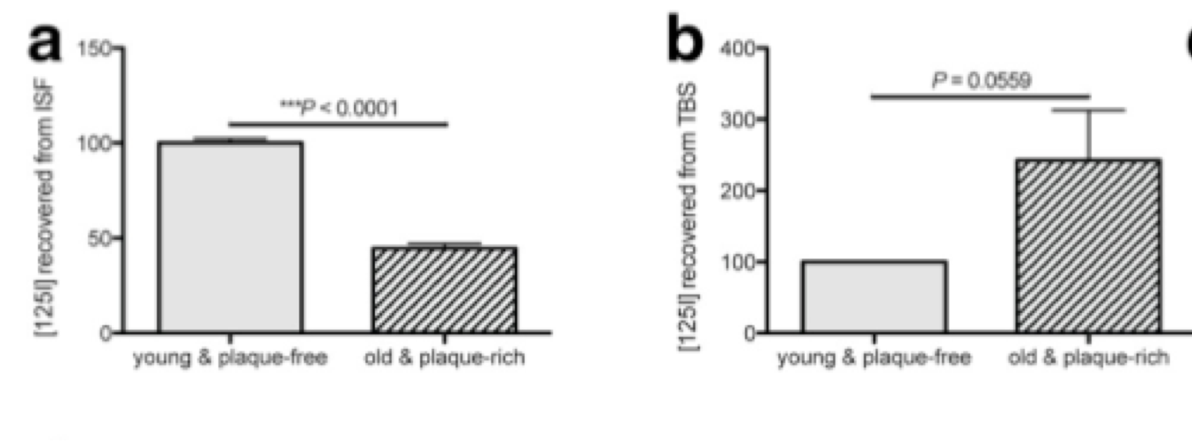
Higher levels of exogenous, NOT newly synthesized Abeta
are sequestered from the ISF in plaque-rich animals

Slide 22
Demonstration that the plaque attracts soluble Abeta

Slide 23
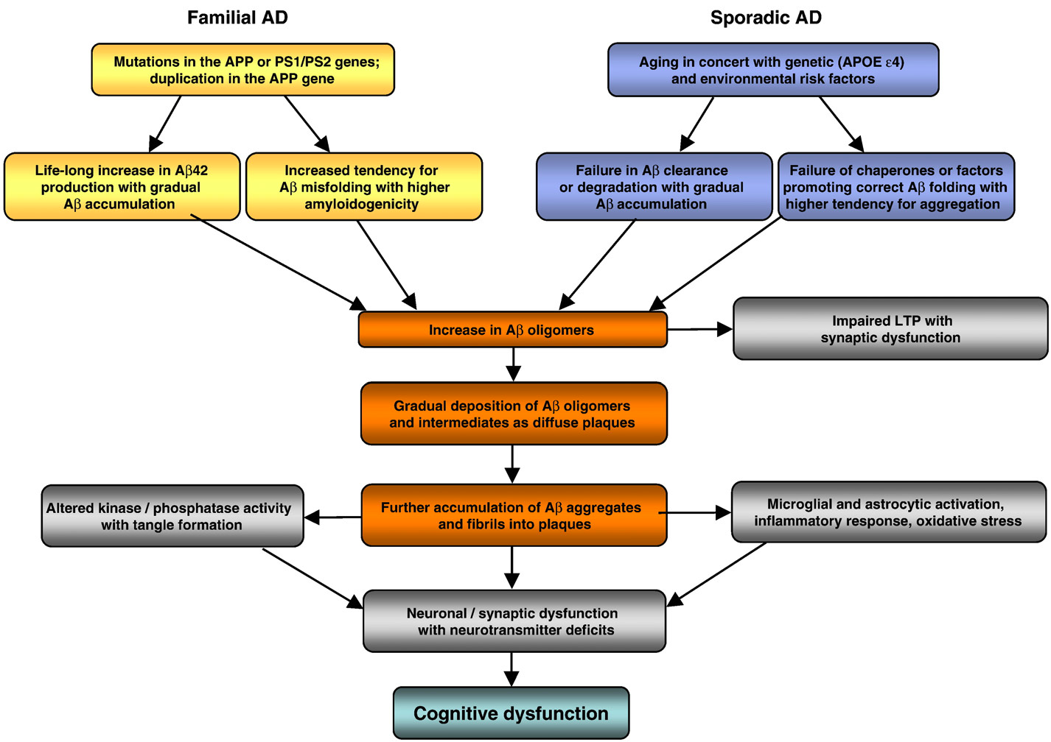
AD pathogenesis in familial and sporadic AD

Slide 24
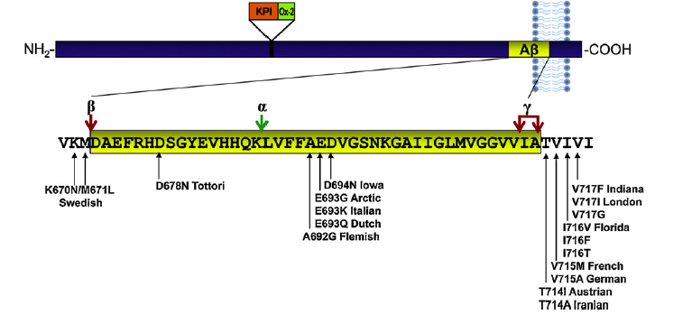
Map of APP mutations used to generate mutant AD mice

Slide 25
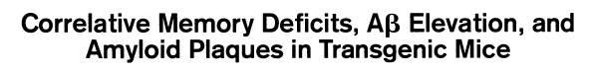
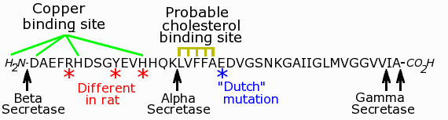
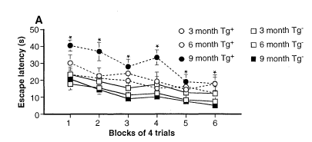
K670M/N671L
Swedish Mutation APPtg2576

Slide 26
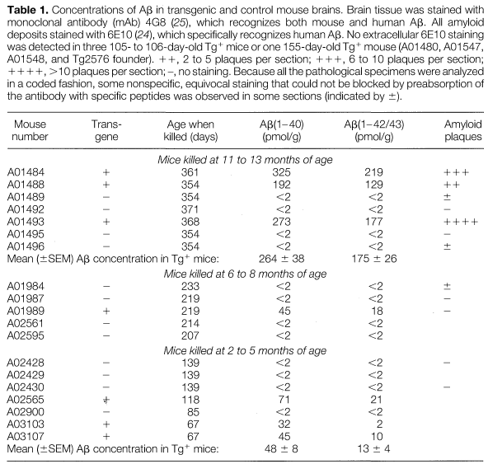
Abeta levels in the brain of APPtg2576
APPtg2576
control

Slide 27
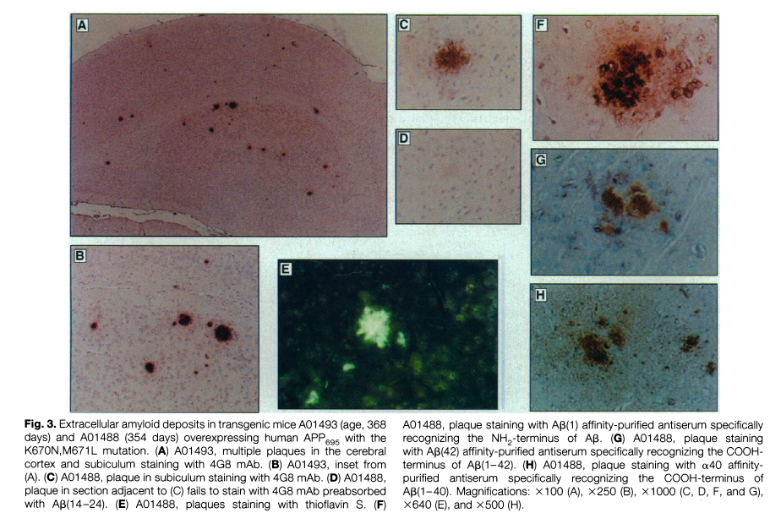
APPtg2576 is an animal model characterized by
beta-amyloid plaques deposition
N-term Ab
N-term Ab
1-42
C-term Ab
1-40

Slide 28
K670M/N671L
Swedish Mutation APPtg2576

Slide 29
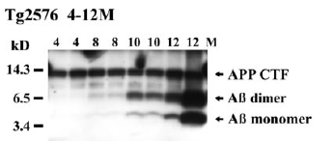
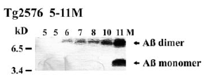
In APPtg2576 Abeta oligomers form and accumulate
before plaque pathology

Slide 30
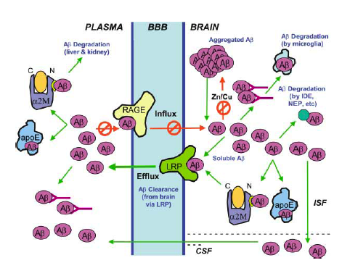
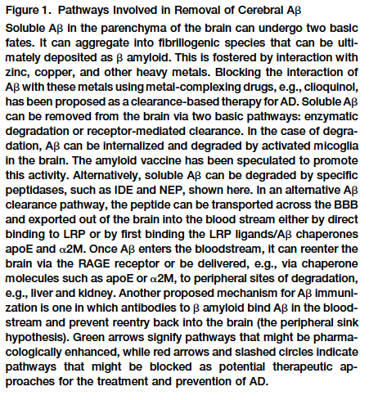
The many ways the system tries to get rid of the Abeta peptides

Slide 31
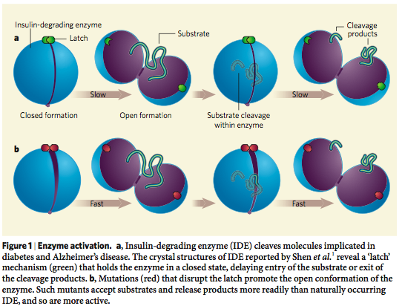
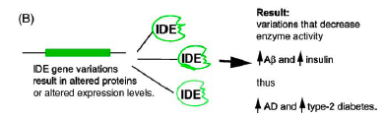
Insulin Degrading Enzyme (IDE) is crucial for Abeta degradation

Slide 32
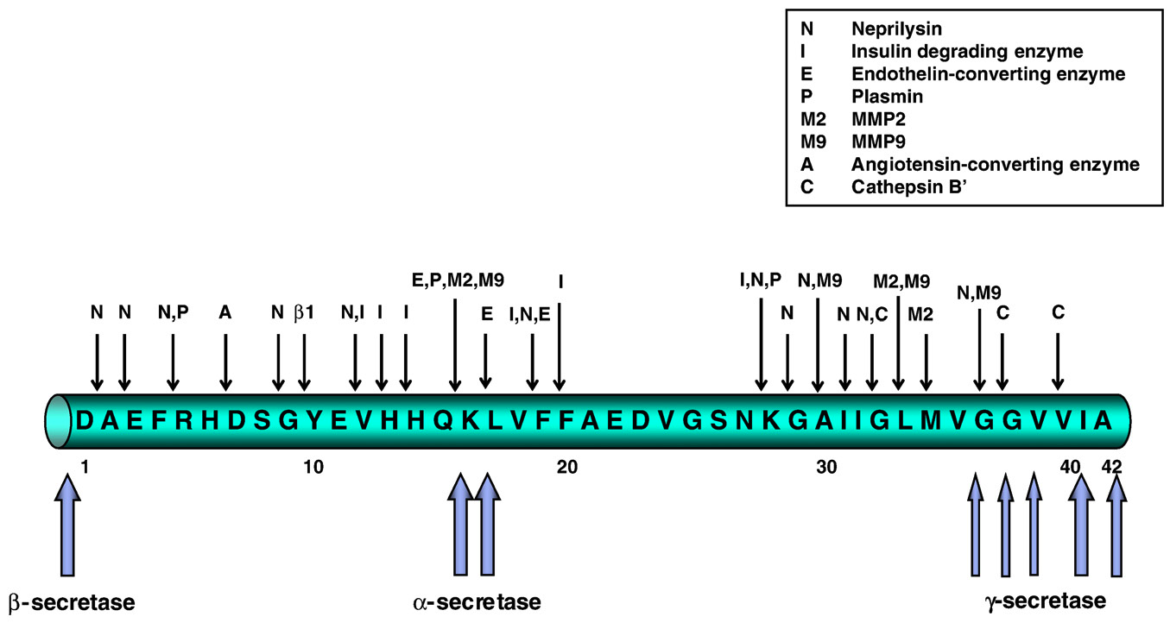
beta-Amyloid can be degraded at multiple sites

Slide 33
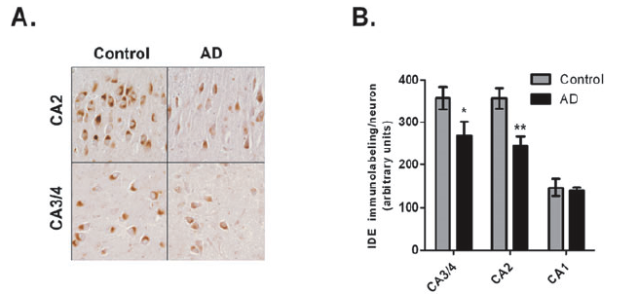
IDE levels are reduced in brain areas affected by AD

Slide 34
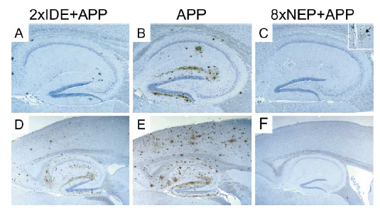
Decreased Aβ plaque burden in animals overexpressing
Insulin Degrading Enzyme (IDE) and Neprilysin
Leissring et al.,

Slide 35
Intracellular trafficking of APP: relation to its physiological function?

Slide 36
Processing of APP
α-secretase
β-secretase
APP
TMD
NH2
COOH
sαAPPs
C83
C99
sβAPPs
γ-secretase
γ-secretase
Aβ
AICD
p3
AICD
Protective
non-amyloidogenic
pathway
Pathogenic
amyloidogenic
pathway

Slide 37
Why do we want to study the trafficking of APP?
Because the intracellular localization of APP INFLUENCES the production of β−Amyloid peptide

Slide 38
Intracellular compartments and processing of APP
α-secretase activity: in the plasma membrane (where metalloproteases, known to have like TACE and ADAM10/ADAM17, reside).
β-secretase activity: mostly in the endosomes, possible also in the ER and Golgi
γ-secretase activity: mostly in the ER, also in lysosomes and possible at the plasma membrane (still under debate).

Slide 39
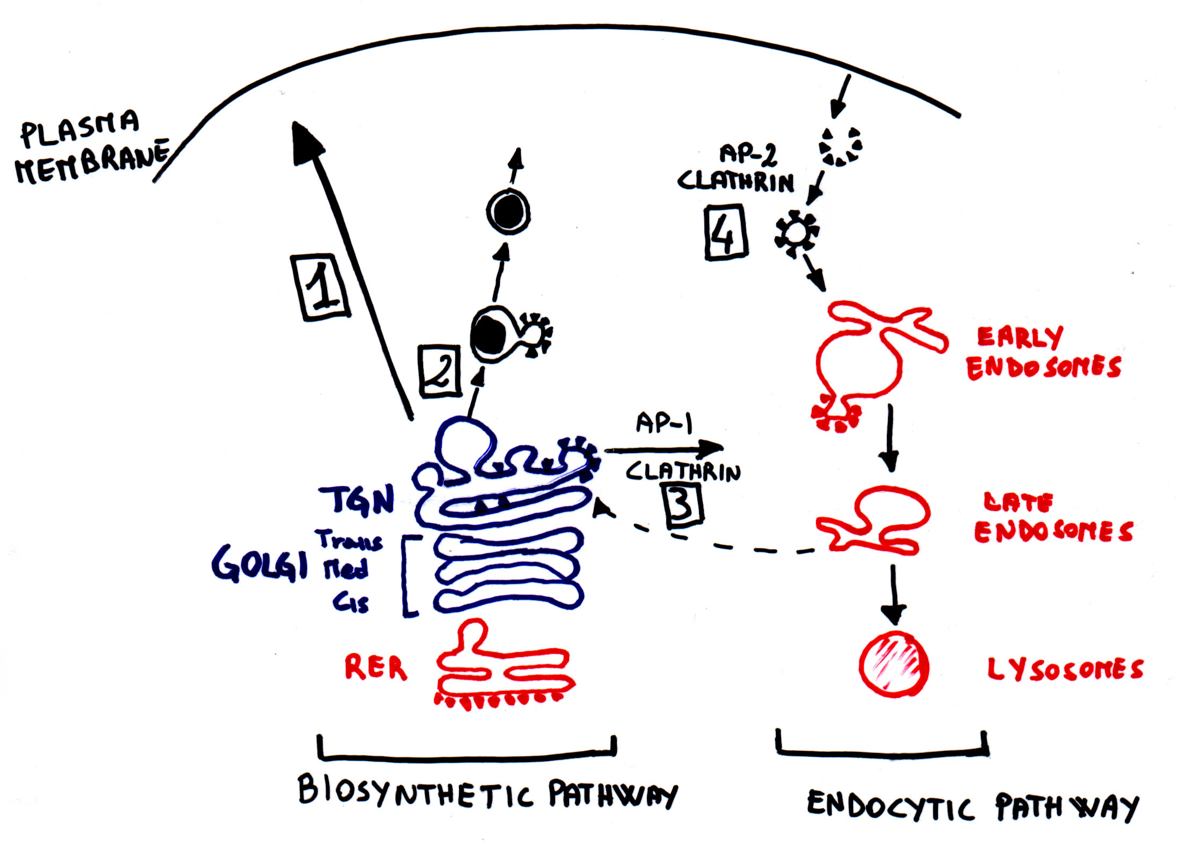
Protein trafficking and endocytosis

Slide 40
Trafficking of APP
APP
αAPP
α-secretase activity
APP
C83
β-secretase activity
C99
βAPPs
C99
AICD
γ-secretase activity
Aβ

Slide 41
APP retained @ plasma membrane =
Internalization of full length APP =
GOOD!!
☺
Protective non-amyloidogenic processing
BAD!!!
☹
pathogenic amyloidogenic processing

Slide 42
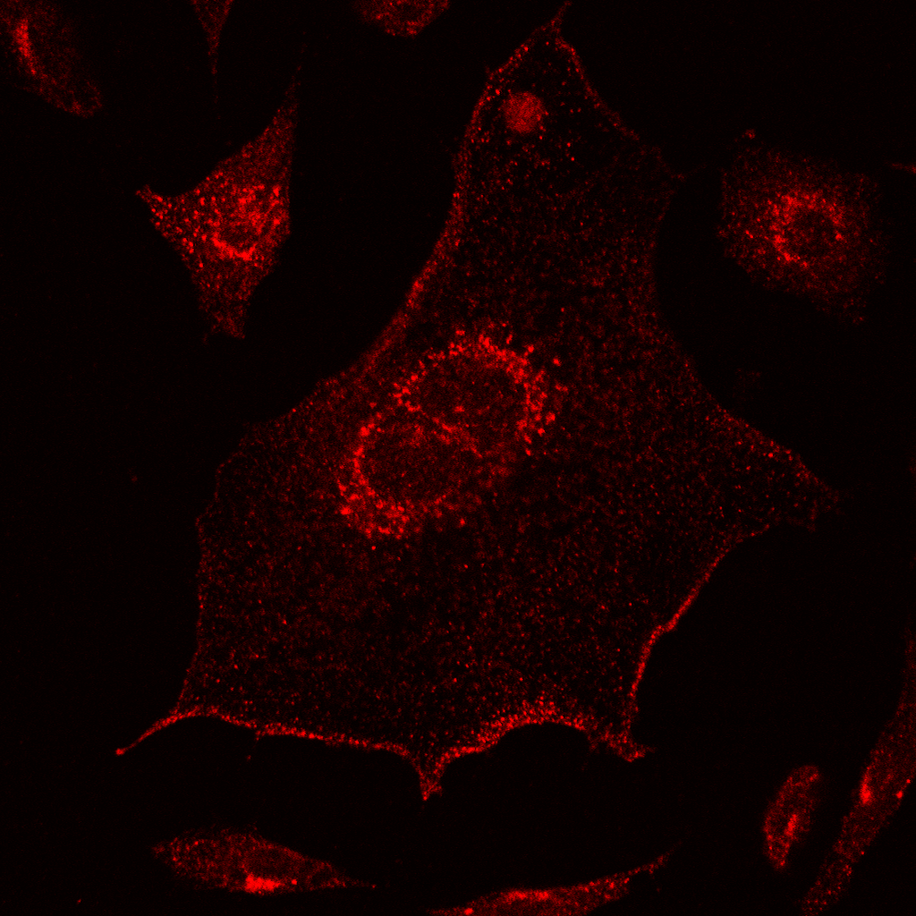
APP localizes to the plasma membrane, Golgi and endosomes
APP
TMD
5A3/1G7
NH₂
Pastorino, JAD 2012

Slide 43
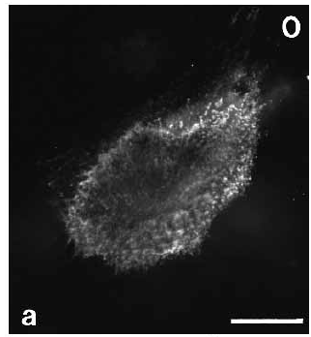
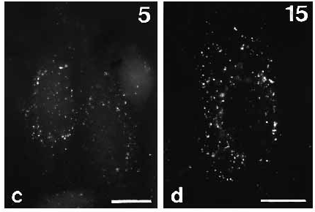
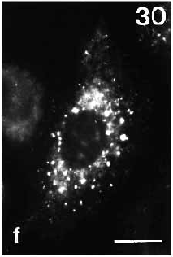
APP internalizes from the plasma membrane into intracellular compartments, endosomes and Golgi
APP
TMD
5A3/1G7
NH₂
COOH
Koo and Squazzo, 1994

Slide 44
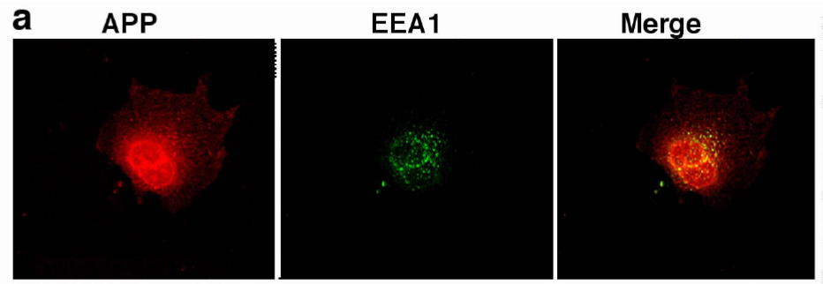
APP co-localizes with the endosomes
Pastorino et al., 2006

Slide 45
Products dowstream of non-amyloidogenic processing:
αAPPs: soluble stub of APP deriving from the α-secretase cleavage :
possible neurotrophic function
p3: c-terminal truncated portion of the sequence of b-amyloid, deriving from the subsequent action of α- and γ-secretase. DOES NOT aggregate. Unknown function.
AICD: APP Intra Cellular Domain, deriving from the cleavage of γ-secretase. Known regulation of transcriptional activity.

Slide 46
Products downstream of the amyloidogenic processing:
βAPPs: soluble stub of APP deriving from the β-secretase cleavage : unknown function
C99: c-terminal stub containing the entire intact sequence of the β-amyloid peptide, deriving from the action of β-secretase. It is the substrate from where β-amyloid peptides derive.
β-Amyloid peptides: generated by the subsequent action of β- and γ-secretases. At very low concentration could be neurotrophic, however, when forming aggregates they are VERY TOXIC and lead to the formation of the core of the β-amyloid plaque in AD
AICD: APP Intra Cellular Domain, deriving from the cleavage of γ-secretase. Known regulation of transcriptional activity.

